Slide 1


“De vegetarische slager”

Slide 2
The butcher of the future
Vegetarian meat = the meat from the future
The future = plant-based
The futue = sustainable

Slide 3
Their purpose
Making plant-based meat the norm
Decreasing our ecological footprint
Reduce the need for cattle

Slide 4
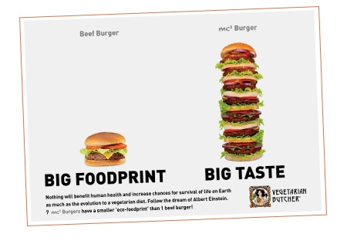

Slide 5
Making it sustainable
Almost no animal products = used
Mostly plant-based
Available in almost every supermarket
Not extremely expensive (as most meat substitutes are)
Available for everyone, no exclusive groups

Slide 6
Sustainability
Lucrative
Job creation
Available for everyone
Available everywhere
Sustainable production

Slide 7
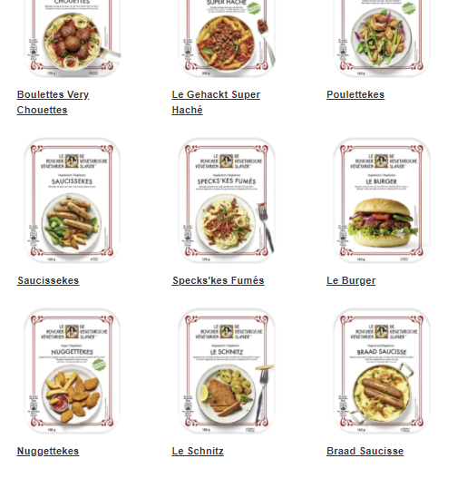
products

Slide 8
Media
https://www.devegetarischeslager.be/
https://www.devegetarischeslager.be/our-story/our-purpose.html
https://www.devegetarischeslager.be/products.html

