Slide 1
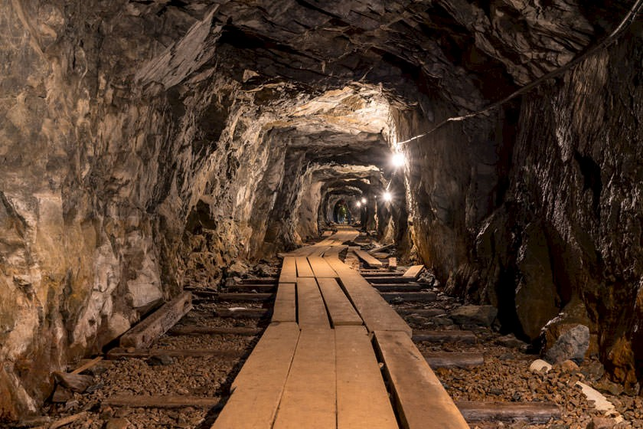
Mining and the enviroment
Carmen R. und Tamara H.

Slide 2
Enviromental impact
Environmental damage through mining (Rohstoffförderung)
Landscapechange
Energy consumption
Water consumption

Slide 3
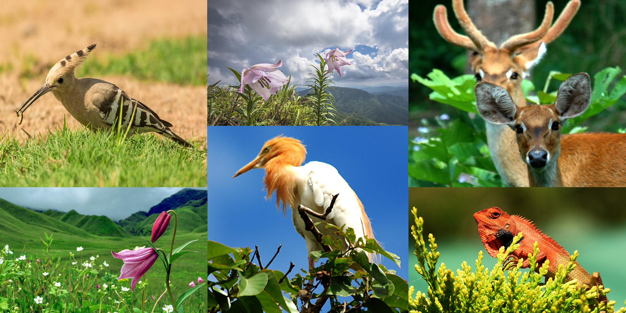
Influence on flora and fauna
Repopulating is often impossible
1/3 active mines
Mining industrie is one of the world’s most energy-intensive industries

Slide 4
Various spheres
Enviroment is made up of various spheres
Constant interaction (Clean air, water, diversity of species)

Slide 5
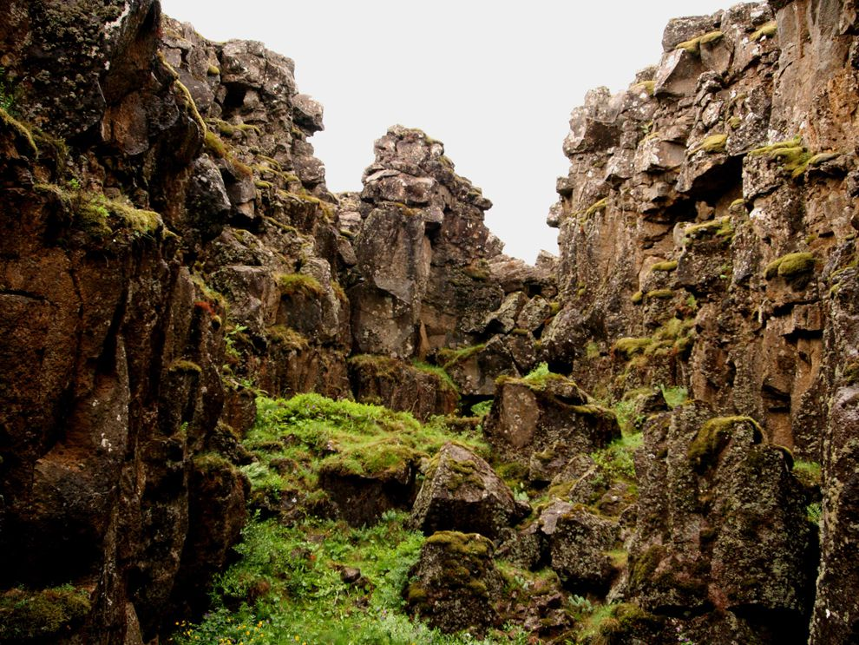
Lithosphere & Biosphere
Lithosphere is the world’s topmost solid layer
Includes soils, rocks and the Earth’s mantle
Biosphere are all living things on Earth
parts of it they inhabit

Slide 6
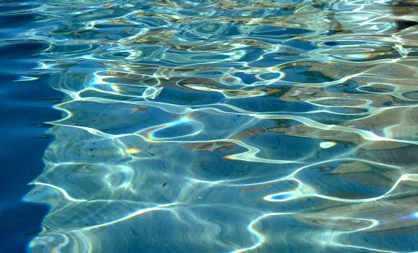
Atmosphere & Hydrosphere
Atmosphere is the layer of gasessurrounding the Earth
Includes the Earth’s entire mass of water
above and below ground
75% of Earth’s surface is covered in water

Slide 7
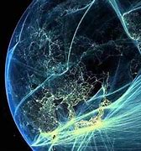
Anthroposphere
Enviroment created and influenced by humans
For example agricultural and infrastructure

Slide 8
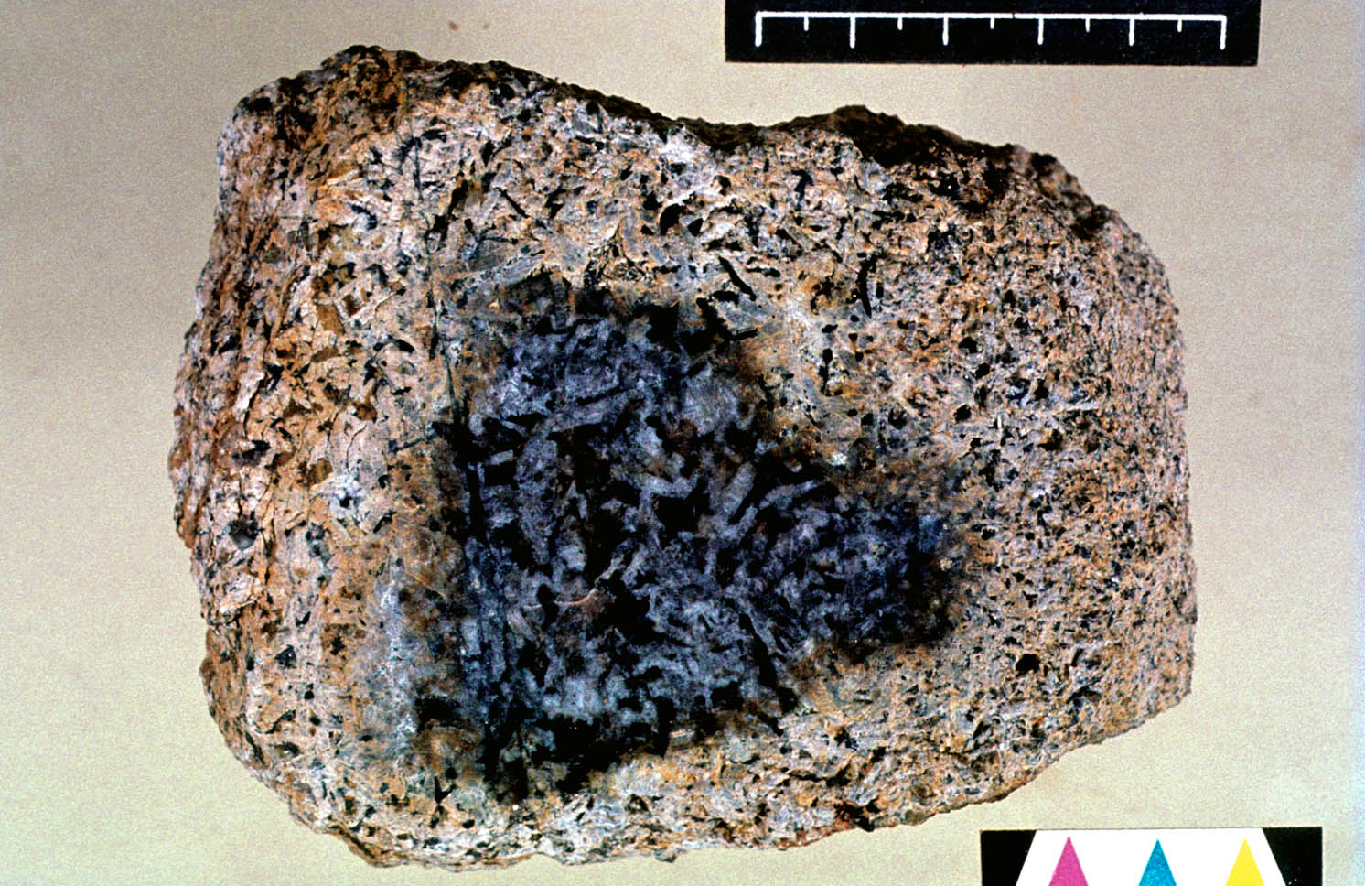
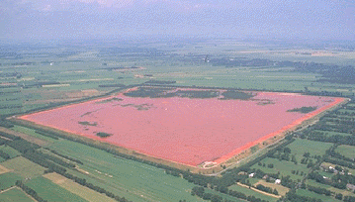
Aluminium
Mining
Extraction
Bauxit (rock weathering)
Aluminium axide
one unit aluminium axide = two units of wastewater (red mud)

Slide 9
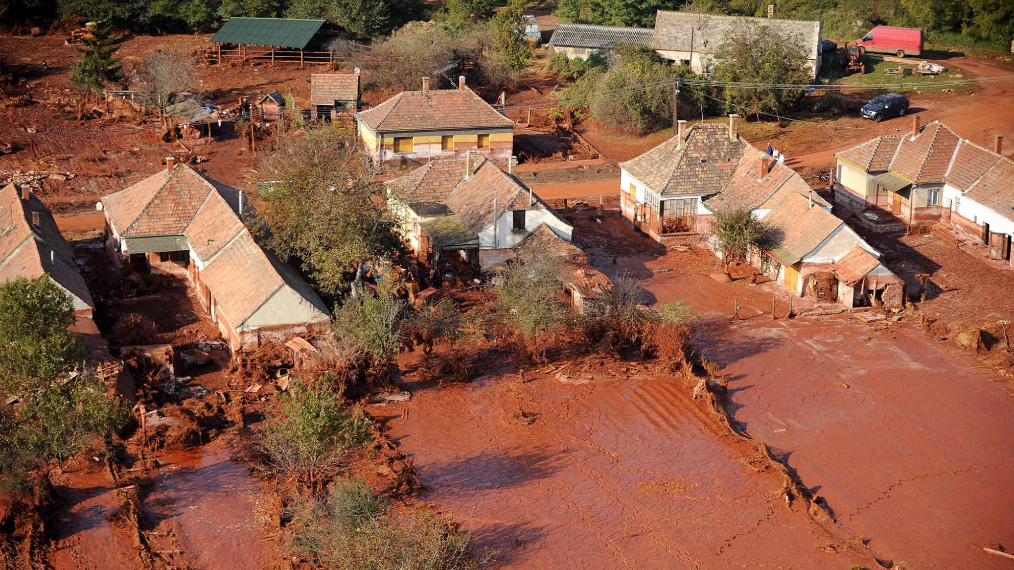
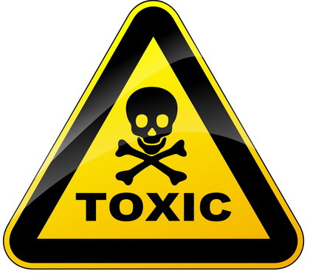
Problems
Red mud is really toxic
Orginial soil* structure cannot be restored completly
                *Boden

Slide 10
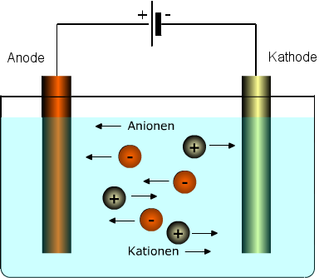
Electrolysis
Pure metal production from aluminium axide (electrolysis methode)
Main centres: China (coal)
          Russia (nuclear power, fossil fuels)
          Iceland (geothermal energy, hydrapower)
          Big amount of air pollutants

Slide 11
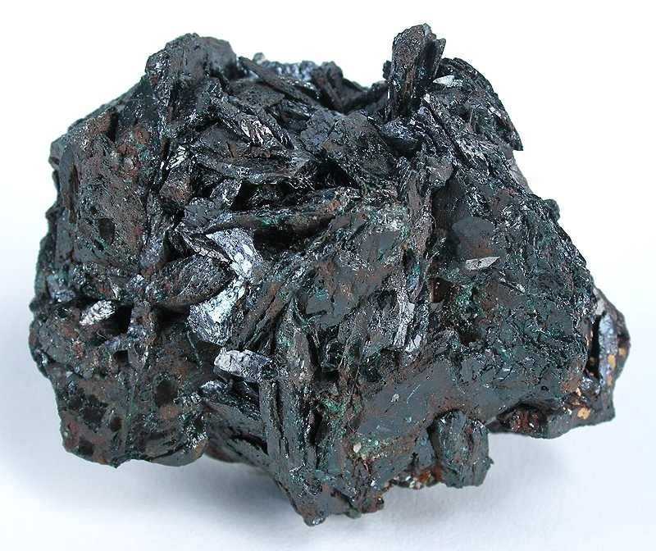
Copper
Mining
Extraction
Copper from ores
→ copper sulphides
Sulphur seperated from copper
(sulphur dioxide used to make sulphuric acid)
Copper processing leads to the emission of particulate matter

Slide 12
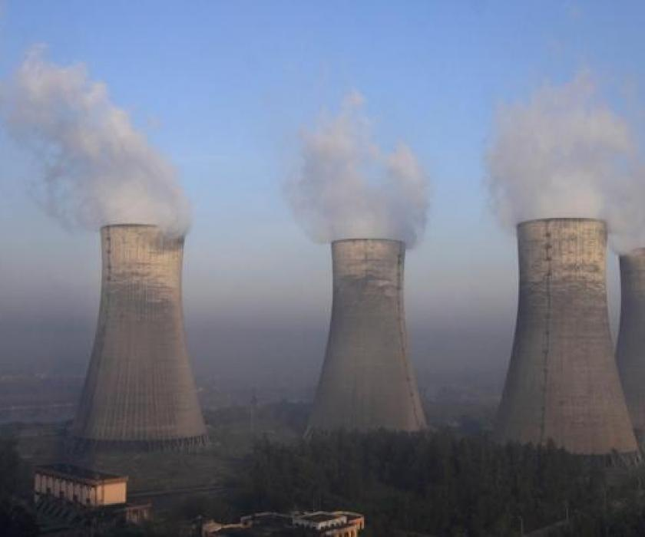
Problems
Sulphuric acid washed into the surrounding area by rainwater
→ higly acidic, toxic concentrations of heavy metals
Strong smelling sulphur dioxide escapes into the air
→ Irritation of the mucous membranes* and diseases, poisoning of soils, animals and plants
* Schleimhautreizungen

Slide 13
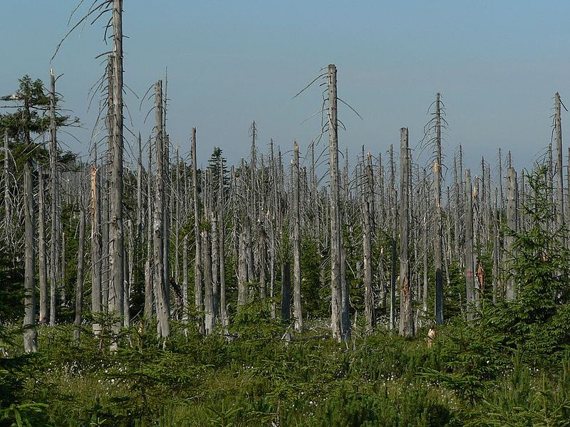
Acid rain
(largest emission of sulphur dioxide)
1. Burning coal
2. copper mining
3. traffic
→ acid rain = acid soils
    Toxic heavy metals released in the soil and plants = organisms disturbed and damaged
    Rivers and lakes are acidify
    Acid rains damages buildings and sculptures

Slide 14
Question
What makes «red mud»?
dirt
process of aluminium extraction
process of copper extraction

Slide 15
The End
Sources:
https://sway.office.com/31XYW2LAAaZdehgI
https://www.google.com/search?q=acide+rain&tbm=isch&ved=2ahUKEwi04ILtu47sAhWB-6QKHVr_CVUQ2-cCegQIABAA&oq=acide+rain&gs_lcp=CgNpbWcQAzIECAAQEzoECAAQQzoFCAAQsQM6AggAOgQIABAeOgYIABAeEBM6CAgAEAUQHhATOggIABAIEB4QE1CIyxpYg9MaYPvUGmgAcAB4AIABngGIAdEJkgEDMi44mAEAoAEBqgELZ3dzLXdpei1pbWfAAQE&sclient=img&ei=MDZzX7SIK4H3kwXa_qeoBQ&bih=722&biw=1536&rlz=1C1GCEA_enCH914CH914#imgrc=v1IMKieMNmOjlM
https://www.google.com/search?q=sulphur+dioxide&tbm=isch&ved=2ahUKEwjakv-luY7sAhWP76QKHb6OAWkQ2-cCegQIABAA&oq=sulphur+dioxide&gs_lcp=CgNpbWcQAzICCAAyBAgAEB4yBAgAEB4yBAgAEB4yBAgAEB4yBAgAEB4yBAgAEB4yBAgAEB4yBAgAEB4yBAgAEB46BAgAEEM6BQgAELEDUI3EKVj24SlghuMpaABwAHgAgAGwAYgB7w6SAQQwLjE0mAEAoAEBqgELZ3dzLXdpei1pbWfAAQE&sclient=img&ei=gjNzX9rJNY_fkwW-nYbIBg&bih=722&biw=1536&rlz=1C1GCEA_enCH914CH914#imgrc=qpsS2JoDUzBwcM
https://www.google.com/search?q=kupfererz&tbm=isch&ved=2ahUKEwiZ3qCauY7sAhWPD-wKHTSEDS4Q2-cCegQIABAA&oq=kupfererz&gs_lcp=CgNpbWcQAzICCAAyAggAMgIIADICCAAyBAgAEBgyBAgAEBgyBAgAEBgyBAgAEBgyBAgAEBgyBAgAEBg6BAgAEEM6BQgAELEDOgYIABAFEB5Qoa8BWL2zAWDotQFoAHAAeACAAZkBiAGoBZIBAzAuNZgBAKABAaoBC2d3cy13aXotaW1nwAEB&sclient=img&ei=ajNzX5mBEI-fsAe0iLbwAg&bih=722&biw=1536&rlz=1C1GCEA_enCH914CH914#imgrc=J_Gs6ZTgbYVzfM
https://www.google.com/search?q=bauxid&tbm=isch&ved=2ahUKEwjV7ub4vo7sAhWIq6QKHZEJC54Q2-cCegQIABAA&oq=bauxid&gs_lcp=CgNpbWcQAzICCAAyBggAEAoQGDoECAAQQzoFCAAQsQM6BwgAELEDEENQvo8DWNCYA2DrmQNoAHAAeACAAZ0BiAH1BpIBAzAuNpgBAKABAaoBC2d3cy13aXotaW1nwAEB&sclient=img&ei=bjlzX9X_K4jXkgWRk6zwCQ&bih=722&biw=1536&rlz=1C1GCEA_enCH914CH914#imgrc=ol5DnBjiLG7UTM
https://www.google.com/search?q=bergbau&tbm=isch&ved=2ahUKEwjzna2wv47sAhVigqQKHf6mAkoQ2-cCegQIABAA&oq=bergbau&gs_lcp=CgNpbWcQAzICCAAyAggAMgIIADICCAAyAggAMgIIADICCAAyAggAMgIIADICCAA6BQgAELEDUNerAVjQtgFgqL0BaABwAHgAgAGHAYgBhAaSAQMxLjaYAQCgAQGqAQtnd3Mtd2l6LWltZ8ABAQ&sclient=img&ei=4zlzX7OgDeKEkgX-zYrQBA&bih=722&biw=1536&rlz=1C1GCEA_enCH914CH914#imgrc=ZMydq-eoniyB4M

